Slide 1

Professional Services - TL1 Script Generators
The Preparation Phase for TAC Engineers on Projects
TL1 Script Preparation
Highly Variable Prep Times
Stressful for newbies and or time crunched seasoned TAC Engineers
MOP Preparation
Project Understanding Gaining a High Level Understanding
Resolution: Technical Guidelines
17 Guidelines Currently Written
and posted to CPOINT
Resolution: MOP Repository
48 MOPs posted to CPOINT
The Problem: putting together TL1 Scripts takes too much time.

Slide 2
Professional Services - TL1 Script Generators
Additional Noise 1: Working Existing TAC Issues
Additional Noise 2: Trying to Secure VPN access or leaving VMAILS for the Customer
Additional Noise 3: Just coming out of a Night Shift week
The Preparation Phase for TAC Engineers on Projects
TL1 Script Preparation
Highly Variable Prep Times
Stressful for newbies and or time crunched seasoned TAC Engineers
Project Understanding Gaining a High Level Understanding
MOP Preparation

Slide 3
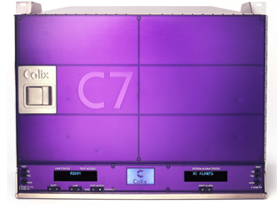

Professional Services - TL1 Script Generators
1. Retrieve cross-connects
TL1 Script Generator
2. Cross-Connect data returned
3. Output a DELETES file with the TL1 Commands to delete the existing cross-connects
4. Ouputs a CREATES file with the TL1 Commands to create new cross-connects

Slide 4
Professional Services - TL1 Script Generators
The Preparation Phase for TAC Engineers on Projects
Project Understanding Gaining a High Level Understanding
TL1 Script Preparation
Easy Prep Times
Easy to “tweak”
MOP Preparation
Resolution: Technical Guidelines
17 Guidelines Currently Written
and posted to CPOINT
Resolution: MOP Repository
48 MOPs posted to CPOINT
Resoluton: TL1 Script Generators being used for Project Preparation

